Slide 1

Requirement Phase 1
Tenacious​

Slide 2

Tenacious ​
Needs
1.Requester- Raise a request to the approver with details of an employee and the reason for a nomination.
2.Approver- Checks the details and approves/rejects the request
3.HR- Checks the award category and trigger the coupons for an awardee.
4.Awardee- Receives mail from HR.
5.Public- View the post, can search and comment.
6.Dashboard- viewed by Higher officials.

Slide 3
Tenacious ​
User Stories
USER STORY ID | As a <type of user> | I want to <perform some tasks> | So that i can <achieve some goal>
1 | Requester | Raise a request for the award | nominate an employee for the award
2 | Approver | Check the performance of the Nominee | Approve or Reject the request raised by requester
3 | HR | Check the category of the award | Trigger mail with the respective coupon
4 | Public | View the list of awards received as feeds | View, Search and comment
5 | Awardee | Receive an award | View the award
Awards
Insta Award​
Role Star​
Gladiator​
First Victor​
Tech Thunder​
Star Innovator​

Slide 4
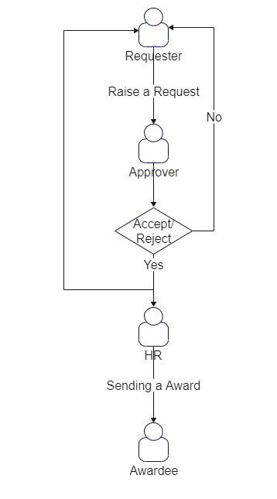
Tenacious ​
Process Flow

Slide 5
Tenacious ​
Queries
Who are the requester and approver for each roles?
What are the eligibility for roles and respective awards ?
Who is Admin ?
Have to mention Awarder or not ?
Is there any award for HR ?
Who are dashboard viewers?

Slide 6


